Slide 1
Crafting Compelling Web Presences
Kaveen.M
MB25

Slide 2
Retail
Wipro’s retail experience has been built over two decades of working with the leading retailers around the globe.
Wipro’s transformational retail IT solutions cover store design, online-to-offline customer journeys and experiences, merchandising, and supply chain transformations.
We enable organizations to shift their AI/ML platforms from an outside layer to the core of retail operations.
As the world evolves into a new normal, the retail and distribution industry remains at the forefront of innovation, agility, and change.
Shifting customer demand, altered spend patterns, last-mile delivery challenges, and reimagined workforce paradigms are here to stay.
Wipro is delivering retail customer experience solutions that allow businesses to respond to these challenges and thrive across different retail segments based on our extensive experience, assets, platforms, and partnerships.
Leading a SHIFT in retail operations.
SEAMLESS: Connect touchpoints and enable omni-channel experiences in stores that are critical for discovery, convenience and engagement.
HUMAN CENTRIC: Re-imagine engagemen, personalize experiences, re-envision associate experience and amplify productivity.
INTELLIGENT: Maximize business value across the retail value chain via smart decisions powered by Big Data, IOT, Analytics & Al.
FUTURE READY: Adopt new business models and new technology, drive change with velocity & scale.
TRUSTWORTHY: Align values with consumers, ensure transparency and reliability, drive sustainability, protect data and assets.

Slide 3
Digitalizing Retail
Get Data to work harder and deliver more.
Extract the maximum value from store information to optimize costs and drive revenue.
Retailers are coming to terms with the digital landscape and the investments needed to re-orient their core systems and processes. Wipro's solutions enable business processes and underlying systems to enable dynamic pricing and promotions, analytics and cyber security.
This means retailers will use Big Data and analytics to answer questions such as:
Growth: Where are we today? What should our roadmap be so that we reach our 5-year target? What are the changes we need to make within the organization to reach our goal?
Financials: How can we use data to balance risk with our vision for growth? How can we improve promotional spends by leveraging data to target hidden opportunities?
Customer: How can we deploy data and intelligence to enrich customer experience? How can we deliver an omni-channel experience that results in improved sales, service and higher loyalty?
Store: What can be done to optimize store operations using data in order to improve inventory, reduce shrinkage, and manage returns – simultaneously with labor optimization and a memorable in-store experience?
Merchandize: How can we innovate around products, markdowns, replenishment accuracy and seasonal volumes to meet customer demands?
Big Data is slated to gain center stage in retail once it begins to shape financial decisions, risk management, diversification, people and resource management and conformance to legal and regulatory requirements.

Slide 4
Solutions
Product Data Enrichment
Play the Data game with Ease.
Enrich product data to drive personalization and take customer-focused decisions.
Wipro’s Product Enrichment Engine (PEE) derives product attributes from unstructured data like ratings, tags and reviews. This granular data becomes a powerful engine that drives personalization, insights and foresights for business users. (assortment, labor, location, etc.)
Product Data Onboarding
Stay ahead with better product data.
Ensure quicker time to market with product data of the highest quality.
Wipro’s ProdIG-e platform provides tools and services to retail clients that ensure the highest quality of product data.

Slide 5
Meaningful Customer Experience
Design Customer- Centric approaches to pricing promotions, assortment playing and other retail functions
In an environment where customers want to be heard, engaged and delighted by their favorite brands, Wipro provides retail clients with the ability to initiate and maintain meaningful real-time conversations with end customers.
What We Think
Analytics in an Omni Channel World.
Every retailer is aware that the shopper expects each experience to be flexible, convenient and enriching.
Enter omni-channel that facilitates browsing from home, adding to the cart via the mobile phone while driving to work, and picking up the product from the store at the end of the day. Omni-channel is meant to provide a unified consumer experience across channels, products and buying stages like in the scenario outlined above.
Solutions
Visibility into Shopper Behavior and Store Performance.
Energize sales using insights from real time and near real time video analytics
Retail clients leverage Wipro Sight, a powerful video analytics solution, which places real time/ near real time intelligence into the hands of store and category managers. The solution analyzes in-store shopper behavior to detect stock outs, analyze shelf space usage, share of category for each product, in-store displays and measures the effectiveness of promotions.

Slide 6
Platforms Used
CMS-Adobe Experience Manager
Programming Languages-Java
Video Players-JW Player, Vimeo
UI Frameworks-Bootstrap
Web Servers-Apache HTTP Server
Paas-Amazon Web Services
JavaScript Frameworks-Ember.js
Form builders-Marketo Forms (2)
Widgets-Marketo Forms (2)
Tag managers-Google Tag Manager, Adobe Experience Platform Launch
Security-Hsts, recptcha
SSL/TLS Certificates authorities-DigiCert
Personalisation-Adobe Target (2.4.1), Demandbase (10.1.15)
Marketing automation-Marketo (163)
JavaScript Libraries-FancyBox (3.5.7), Core-js (2.6.9) jQuery (3.7.1)
Font scripts-Typekit, Font Awesome (4.7.0)
Customer data platform-Adobe Experience Platform Identity Service

Slide 7
Cookie compliance-OneTrust.
CDN-Amazon CloudFont, CloudFlare, cdnjs, Google Hosted Libraries.
Analytics-Google Ads Conversion Tracking, Google Analytics (UA), Hotjar, Linkedin Insight Tag, Adobe Analytics, Demandbase (10.1.15)
Advertising-Google Ads, Twitter Ads, Linkedin Ads.
A/B Testing-Adobe Target (2.4.1)
Miscellaneous-PDF.JS (2.2.228), HTTP/2, Open Graph.

Slide 8
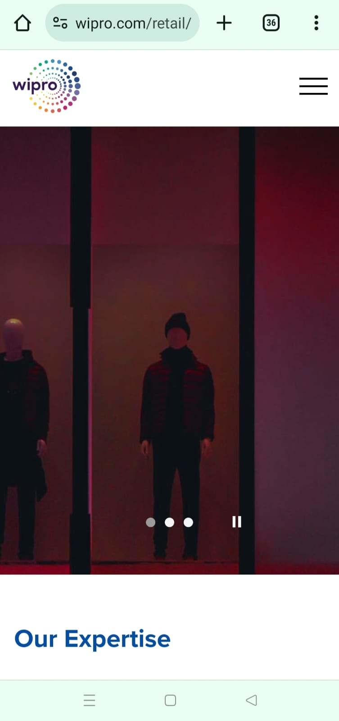
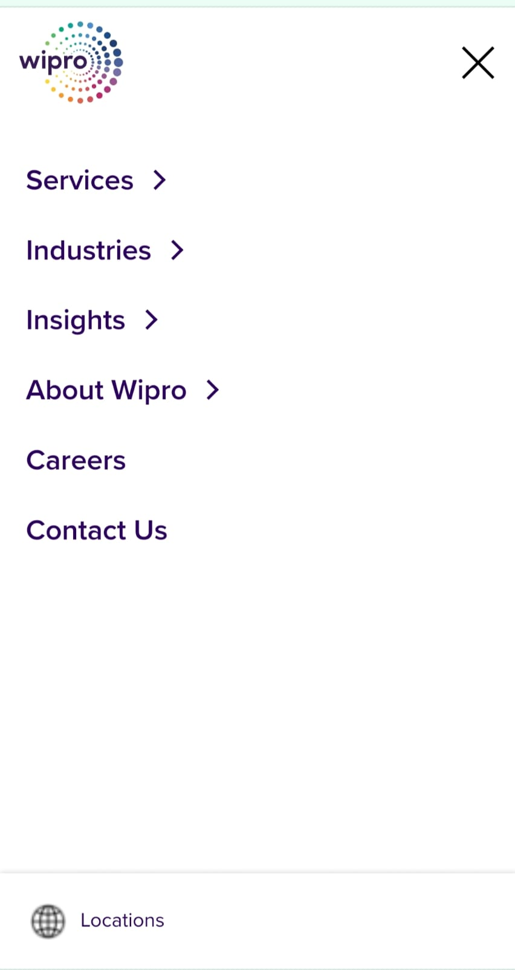
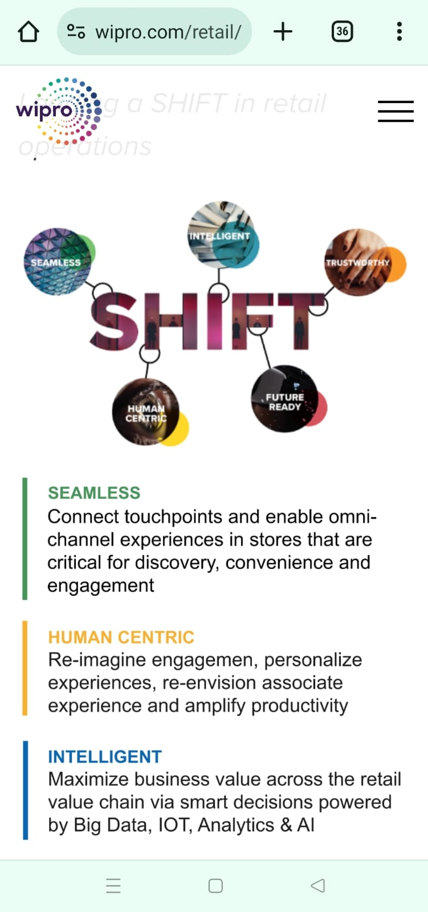
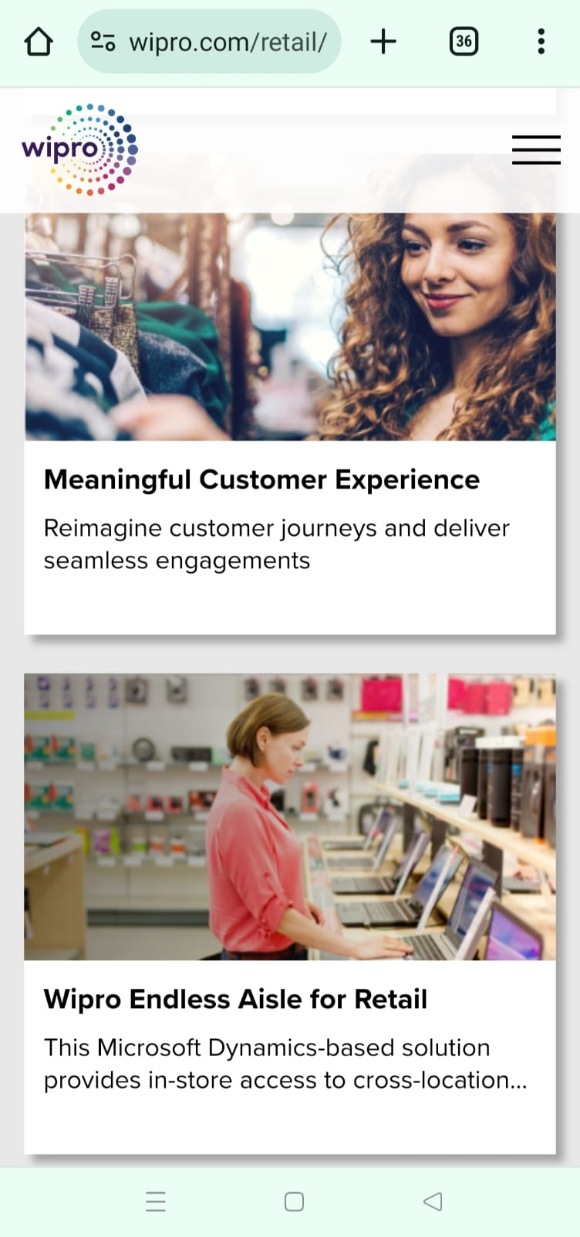
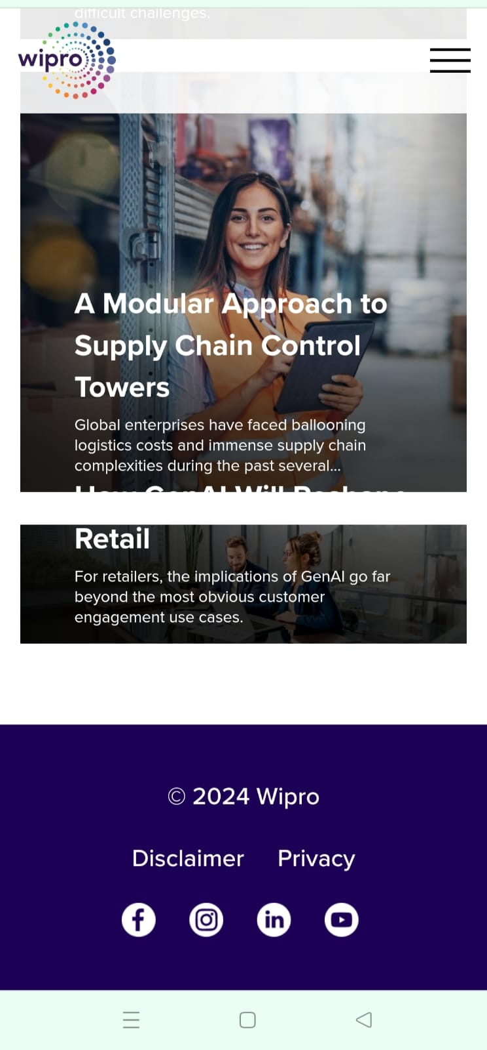
Mobile Phone View

Slide 9
Common Website Design Mistake
Slow page load time.
Unclear Brand Messaging.
Font size.
Colour.
Navigation Issue.
Call To Action.

Slide 10
Suggestion
User friendly websites are to be created to be find it easily
Mailchimp’s intuitive, user-friendly website guides customers to quickly get up and running
User-centric design, Design Conventions, Navigability, Information hierarchy.
Wix, Wordpress, Mailchimp.

Slide 11
Landing Page
https://kaavinmohan.wixsite.com/landingpage

Slide 12
Thank
You

